Slide 1
TA 111A: Technical Arts
2023-24 II
Lecture 13
Sectional Views
Dr. Syam Nair
Department of Civil Engineering
IIT Kanpur
Office: FB 307
Phone: 6424
Email: syamnair@iitk.ac.in

Slide 2
Reading
Thomas E. French, “Engineering Drawing and Graphics Technology”
Chapter 6, Sectional Views and Conventions

Slide 3
Sectional Views
A view of an object when it is ‘sectioned’ or ‘cut’ by an imaginary plane to reveal interior details of the object
Sectional view is usually (but, not always) parallel to one of the principal orthographic planes e.g. frontal, top, or profile
A sectional view must indicate which portions of the object are solid and which are spaces

Slide 4
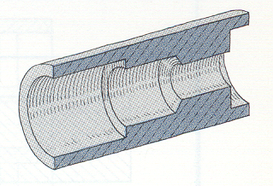

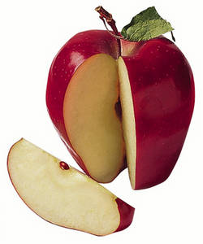
What is Sectioning?
Cutting an object
  Imaginary cut to reveal interior details
Sectional Views
Get Interior details for clarity
Doctors do X-ray, CT-Scan .. How can Engineers ??
Where to cut?
How much to cut?
Must not lose the overall shape and dimension
More important, sectional views should be non-destructive

Slide 5
Why Sectioning ???
A
B
C
Objects with variable dimensions or shape
B
C
A
Section @ AA
Section @ BB
Section @ CC

Slide 6
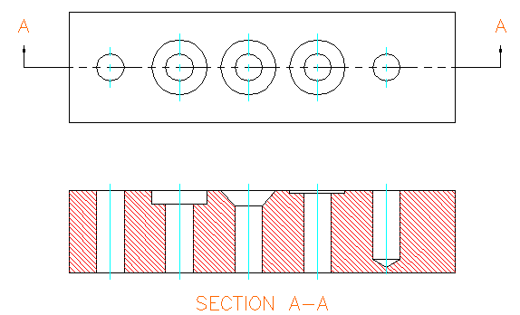
Cutting Plane
An imaginary plane that cuts the object
Generally indicated in an adjacent view with a line and two arrows
  Line: Long dash + 2 short dashes
Generally named by letters : AA, BB etc.
A
A

Slide 7
Basics
Which piece is being viewed and how?

Slide 8
Basics
Which piece is being viewed and how?

Slide 9
Basics
Cutting plane
  Location of cut/section chosen must be identifiable in drawing

Slide 10

Genesis
Some objects have different shapes on the exterior and in the interior
  Sectioning used to provide details of the interior

Slide 11
Genesis
Outside shapes don’t reflect inside shapes

Slide 12
Genesis

Slide 13



  Showing details can be difficult if object has many hidden lines
Cutting Plane
X
X
  Guess what this object is !!!
A
Can you visualize this
B

Slide 14
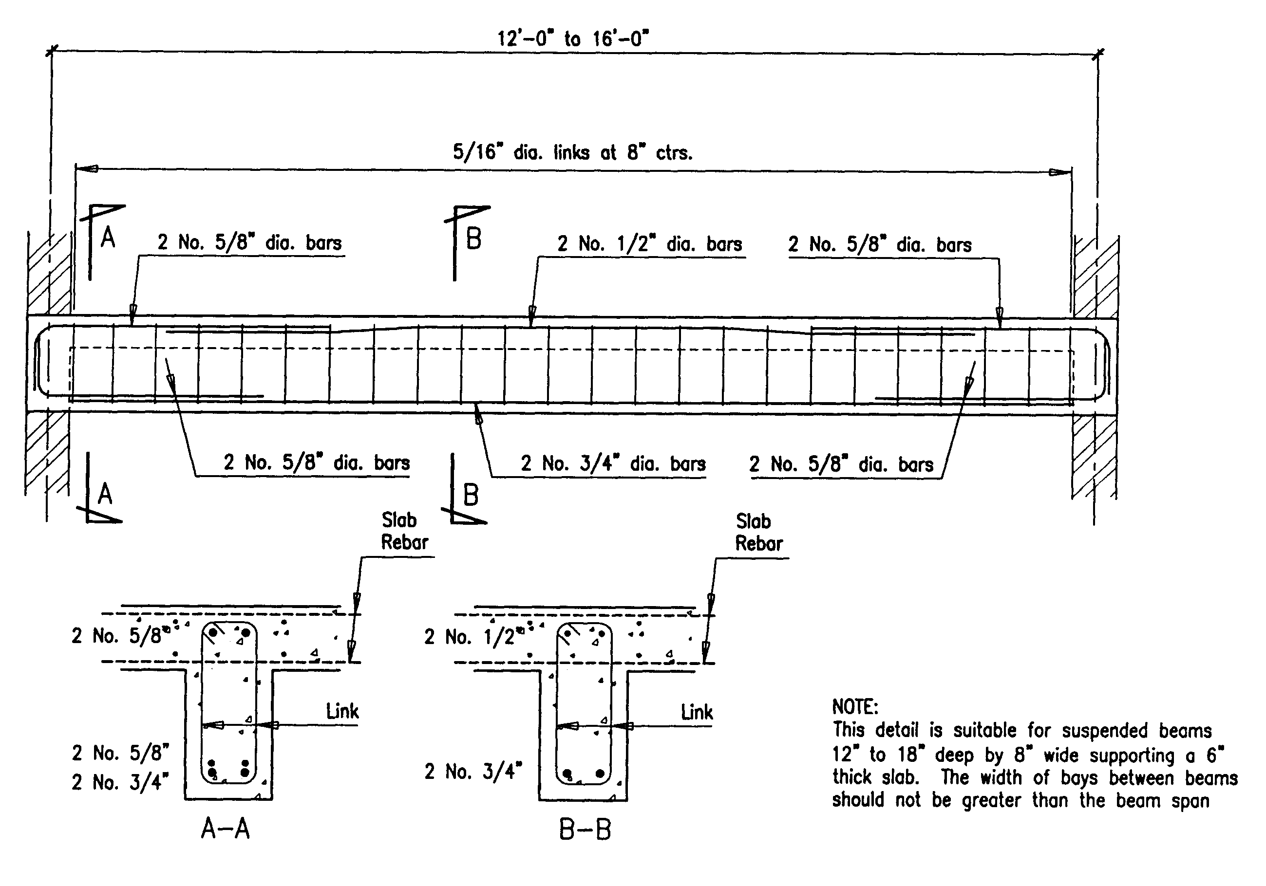
Need for sectioning: Civil Engineering ….

Slide 15
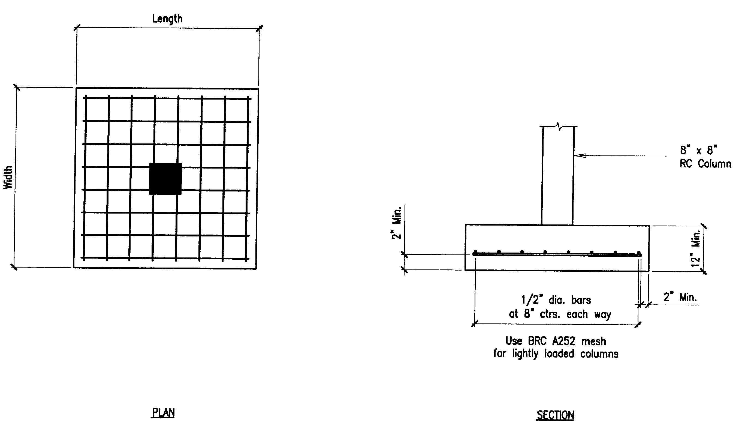
Need for sectioning ….
A
A
AA

Slide 16
General Principles of Section Drawing
Identify the place where section is taken in drawing
Solid portions and voids must be differentiated
Direction arrow to show how the object is being looked at
Observe some conventions
The imaginary plane that cuts the object is called cutting plane
or section plane – generally parallel to plane on which sectioned
view is to be projected.
Differentiate between Solid and Void – Hatch the cut solid
Within sectioned (hatched) view, dashed lines are omitted unless
absolutely essential
Hatching lines should be uniformly spaced and lighter than
object lines – use 3H/2H pencil

Slide 17
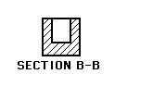
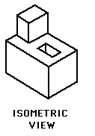

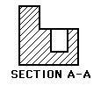


Simple Object and Concept
Top
Front
Profile
Results of section at A-A will be reflected in the front view
Results of section at B-B will be reflected in the side view
Observe – (i) How to show section plane and what arrow means
(ii) Hatching to differentiate solid and void/spaces

Slide 18
Hatching
Direction of hatching for the same object
A
A
Section AA

Slide 19
Hatching
Direction of hatching for the same object…
  Single component - same direction of hatching

Slide 20
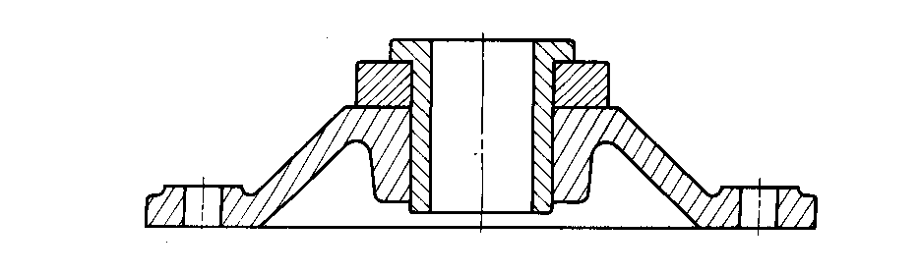
Drawing Sectional Views
Different parts are hatched at different angles
Means of showing solid portions of object…
  Different hatching for different components, even if made of same material

Slide 21
Hatching
Preferred direction of hatching
  30°, 60° & 75°

Slide 22
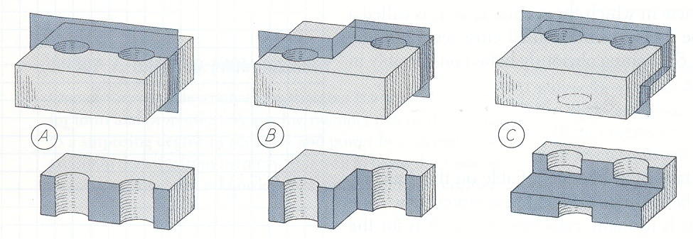
Full Section
Cutting plane passes completely through the object
One cutting plane, it need not be straight

Slide 23
Example 1
Block with a hole

Slide 24
Example 1
Block with a hole

Slide 25
Example 2
Block with two holes: Cutting plane

Slide 26
Example 2
Block with two holes
  Change in plane direction not shown in section view
  Cut is imaginary: No edges present

Slide 27
Example 3
Block with three holes

Slide 28
Example 3
Block with three holes
  Different cutting plane

Slide 29
Thank you !!!

